Slide 1
Recommendations on how to improve support to fulfill SLA

Slide 2
Total number of Tickets for the years 2019, 2020, 2022
The teams dealt with 513 tickets
It can be seen from the chart that 444 tickets have been closed and 57 tickets are
still open and 12 resolved
To improve the SLA than the timeframe to close the remaining open tickets should
be reduced

Slide 3
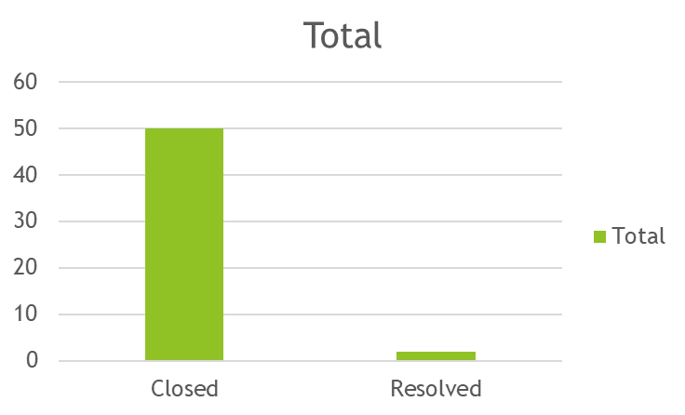
To fulfil the SLA the teams have resolved correctly the tickets in order of priority:
1.Emergency 50 tickets have been closed and 2 resolved
High tickets being 103 from which 97 have been closed, only 4 still open and
2 resolved.

Slide 4
The number of tickets have to be well assigned to the correct Department according to their difficulty:
Internal Technical Department to close the 23 open tickets
SAP JDE Support Department to close the 34 open tickets

Slide 5
To fulfil the SLA the tickets have to be well recorded into the two handling
categories:
Incident/Problem 345 tickets
Request 168 tickets
To improve the SLA the number of overdue tickets should be reduced
from 34.

Slide 6
To improve the SLA the number of tickets answered by each agent should be
more equally as it can be seen that some agents have been assigned too many:
Aurora Miller 81 tickets
Belle Garner 1 ticket
Melody Thomson 42 tickets
Paul Smith 2 tickets

Slide 7
In conclusion to improve support to fulfil the SLA :
The average time of handling the tickets should be reduced for the 57 still open tickets
To continue resolving tickets according to their priority and to close the 4 tickets still open being of high priority.
The tickets to be assigned to the correct Department and each department to try and close the open tickets in the right timeframe.
The tickets to be recorded correct under one of the two handling categories
To assign the number of tickets to be answered more equally between staff
The number of overdue tickets should be reduced from 34 .

